Slide 1
Obstacles
Mack 2023

Slide 2
Learning Objectives
Students will understand the concept of a game over state in a 2D game.
Students will be able to set up a game over function in their game.
Students will be able to create an enemy scene in a 2D game.
Students will be able to implement spikes as nodes that trigger the game over function when the player collides with them.

Slide 3
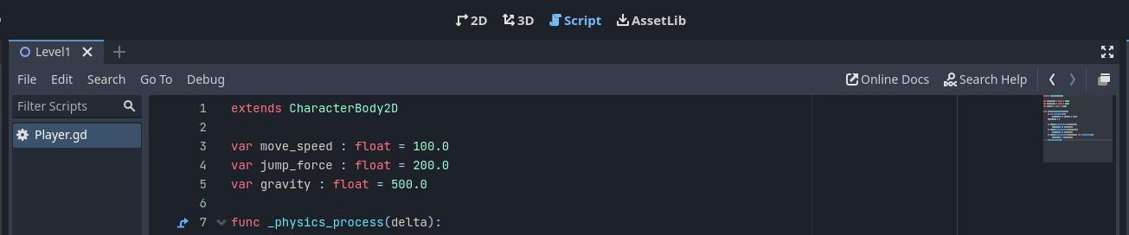
Setting up the Game-Over Function
The first step is to create a game-over function in the player script. To do this, return to the Script tab, and make sure the Player.gd script from the last lesson is still open.

Slide 4

Setting up the Game-Over Function
At the bottom of the script, add the new function using the following line:

Slide 5

Setting up the Game-Over Function
This function will simply reload the current scene. To do this, we need to get the node tree and then call the reload_current_scene() function on the tree.

Slide 6
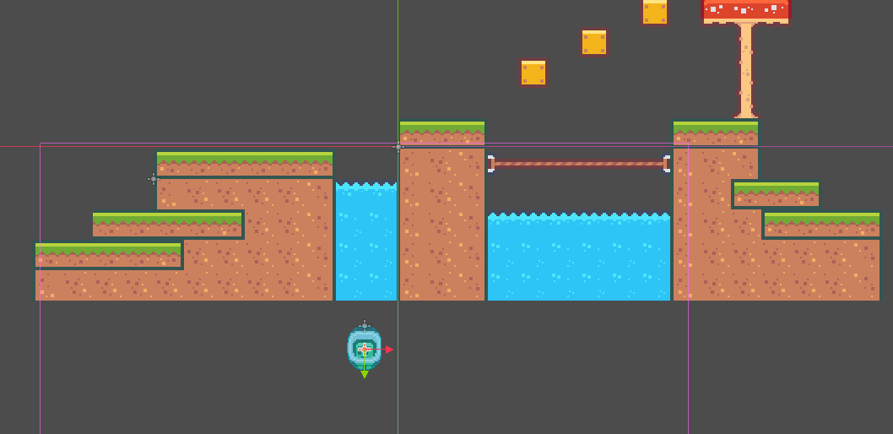
Checking for Fall Deaths
The next step is to check the player’s position, if they are below the terrain, we want to call the game_over function. The first step is to find a position under your world by dragging your Player to the lowest position they should be able to reach.

Slide 7
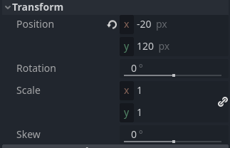
Checking for Fall Deaths
And check the Y position value to find the lowest position you want the player to reach. For us, we will be using 120 pixels or lower as our range for calling the game_over function.

Slide 8
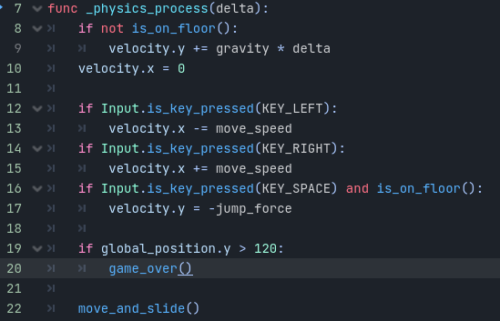
Checking for Fall Deaths
We can then add an if statement to the _physics_process function. This statement will check the player’s Y position and if it is greater than 120 (or the value you found earlier), the game-over function will be called.
Notes:
You can now press Play to test the game, and you will notice if you fall off the platform, the scene will be reloaded.

Slide 9
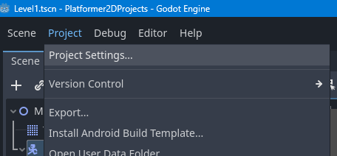
Changing the background
Finally, we can change the background of the game. To do this, open up the project settings window.

Slide 10
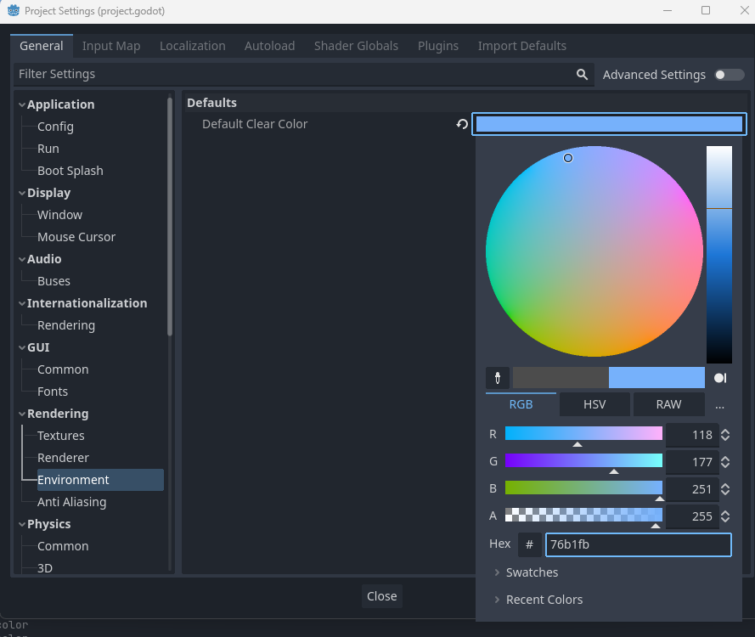
Changing the background
Then open the Environment tab (under Rendering), and we can then change the Default Clear Color. This can be set to any color you want.
Notes:
You will then see the background color in both your scene view and the game if you press Play.

Slide 11
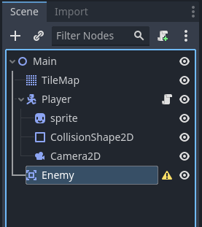
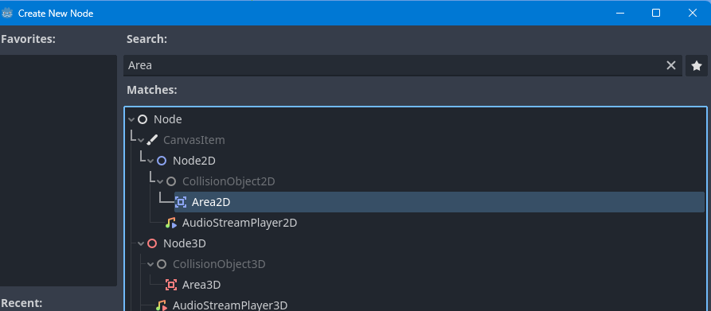
Creating the Enemy Scene
The first step is to create a new node of type Area2D. This node will detect collisions and run an event in the code when another collider passes through it. You can rename this to Enemy.

Slide 12
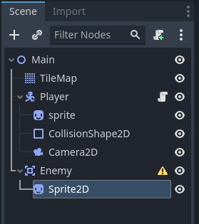
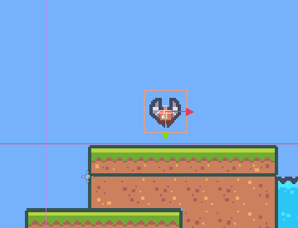
Creating the Enemy Scene
We will then add a Sprite node as a child of the Area2D node. We will be using the character_0024.png sprite from our pack.
Notes:
This will give the enemy a visual representation in the game. We can then rename the node to Sprite.

Slide 13
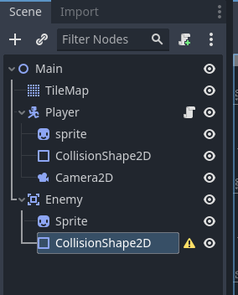
Creating the Enemy Scene
Next, we need to add a CollisionShape2D node to the enemy to give our Area2D a shape to check.

Slide 14
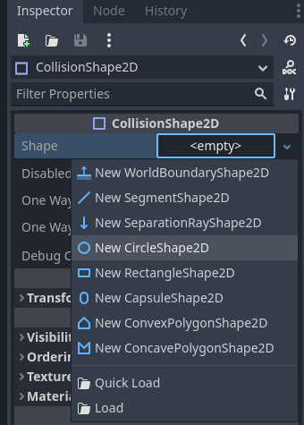
Creating the Enemy Scene
Then set the Shape property to a new CircleShape2D.

Slide 15
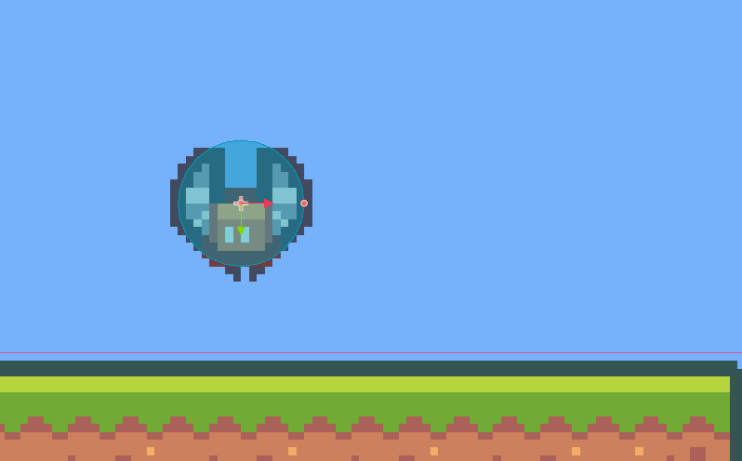
Creating the Enemy Scene
Next, adjust its size to be slightly smaller than the Sprite.
This will allow the player to pass by the enemy without colliding with it but still set off a collision event.

Slide 16
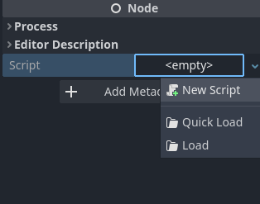
Creating the Enemy Script
With the Enemy node selected, create a new script.

Slide 17
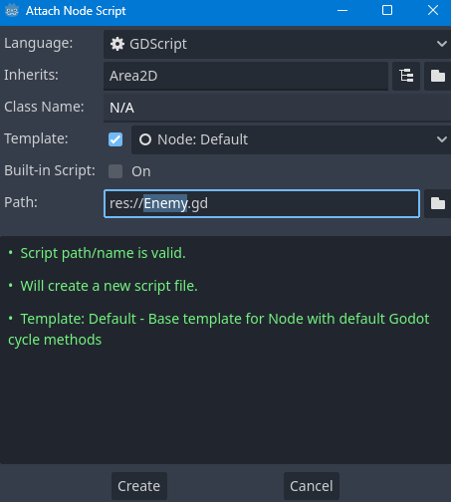
Creating the Enemy Script
This script will be named Enemy.gd and inherit from Area2D, as this is the Enemy node’s type.

Slide 18
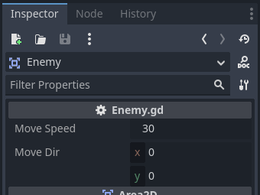
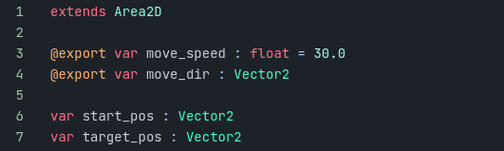
Creating the Enemy Script
This time we will keep the default functions, but we will add variables for the enemy’s move_speed, move_direction, start_position, and target_position.
Notes:
move_speed – The speed at which our enemy will move.
move_direction – The maximum point our enemy will move to before moving back.
start_pos – The position the enemy starts in and will move back to.
target_pos – The position the enemy will move to and away from.
We have used the @export tag to make our variables visible to edit in the inspector.

Slide 19
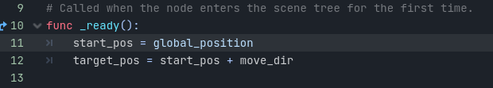
Creating the Enemy Script
With these variables, we can then set the start_pos and the target_pos in the _ready function.

Slide 20

Creating the Enemy Script
We can now create the logic to move toward our target position. This will be done in the _process function, as it runs once every frame.

Slide 21
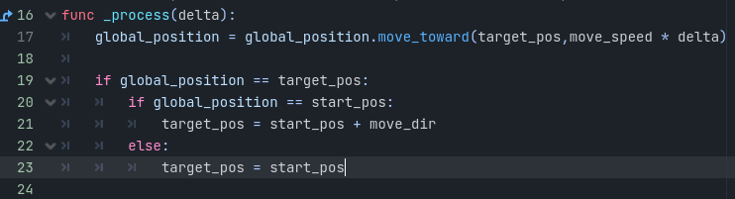
Creating the Enemy Script
We will also need to check to see if we have reached our target position, and if we have, change the target position to the other way.
Notes:
This code will check to see if we have reached our target_pos, and then proceed to check if we are at the start_pos or not. If we are, we will change the target_pos to our move_dir value, if not, we want to move back to the start_pos.
We can now save this script (CTRL+S) and return to the 2D scene view.

Slide 22
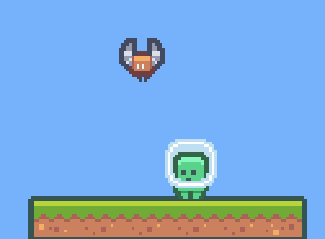
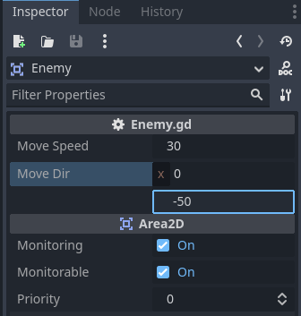
Setting up our Enemy
We now need to set the Move Dir value we exported earlier, we will use the value (0, -50) to state move 50 pixels upward, you can of course change this value however you want.
Notes:
If you now press Play, you will see the Enemy we created go up and down between its start position and target position.
You will notice, however, if you touch the enemy, it doesn’t yet call our game over function

Slide 23
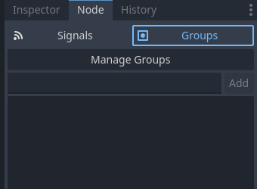
Detecting Collisions
To do this, we will select the Player node and open the Node tab and select the Groups section.

Slide 24
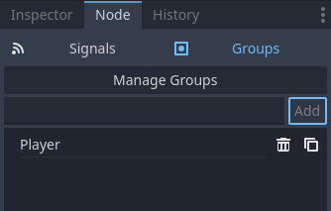
Detecting Collisions
We want to add our Player node to a group, this is like tagging our node and will let us know what type of node a collider is when one is detected by our Enemy. We will add a group to our Player named Player.

Slide 25
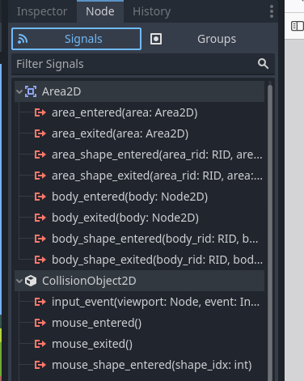
Detecting Collisions
Next, with the Enemy node selected, choose the Signals section this time.

Slide 26
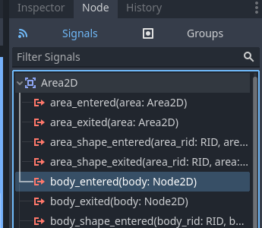
Detecting Collisions
To add a signal to our Enemy, choose the body_entered signal and double-click it.

Slide 27
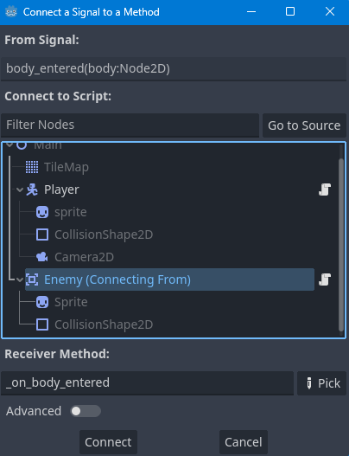
Detecting Collisions
Then select our Enemy node in the list that appears and press Connect.

Slide 28

Detecting Collisions
This will create an _on_body_entered function that will call when the signal is set off. The body parameter passed through the function is the object we have interacted with, so we want to check if this is the Player and call the game_over function if it is. We will do this with the following code at the bottom of the Enemy.gd script:
Notes:
Now if you save the script, and press Play you will see the player is reset when they touch the enemy, as intended.

Slide 29
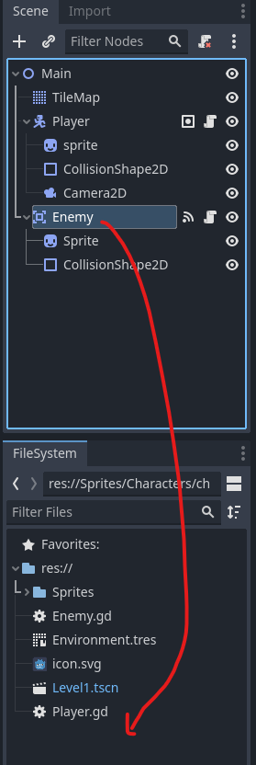
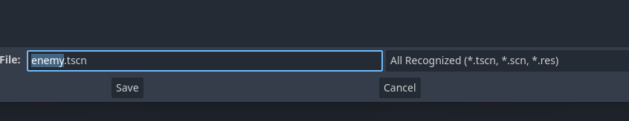
Turning the Enemy into a Scene
We finally need to save the Enemy node tree as a scene. This will allow us to drag in multiple instances of it into the game, and still be able to edit it globally. Do this by dragging the top Enemy node from the Scene tab to the FileSystem tab.

Slide 30
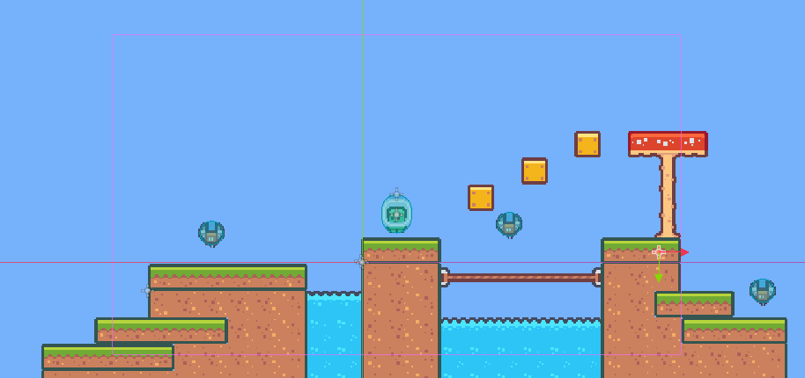
Turning the Enemy into a Scene
You can now copy and paste the Enemy scene around the level and change the Move Dir and Move Speed to make differing enemies.

Slide 31
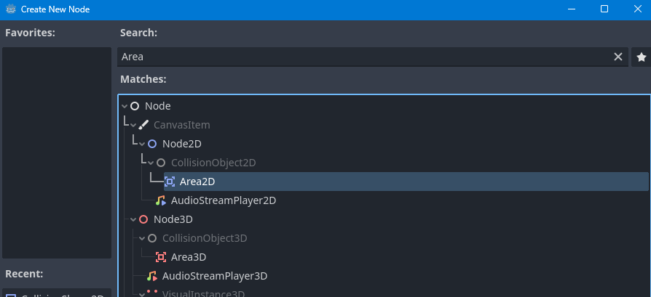
Creating the Spike Node
To begin, we need to create an Area2D node that will act as the base for our spike.

Slide 32
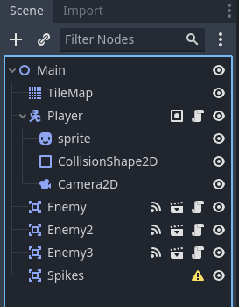
Creating the Spike Node
We then double-click the new node to rename it Spikes.

Slide 33
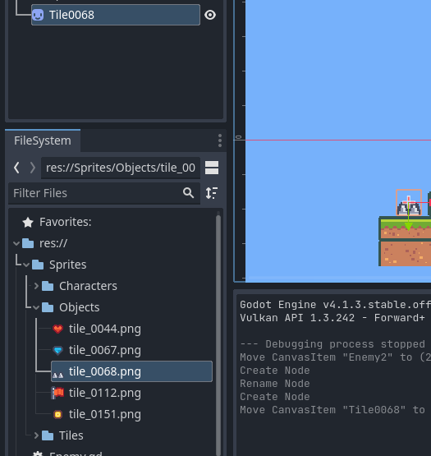
Adding a Sprite
Next, we need to add a Sprite to the node. As with the other sprites, we will do this by dragging a texture into our scene. We will be using the tile_0068.png file for our spikes.

Slide 34
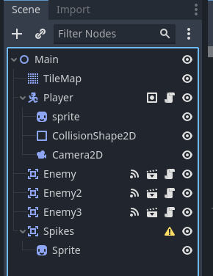
Adding a Sprite
Then make the Sprite a child of the spikes node, and rename it to Sprite.

Slide 35
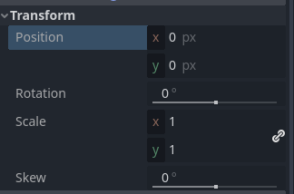
Adding a Sprite
Finally, make sure to set the position of the Sprite to (0,0) to center it inside the Spikes node.

Slide 36
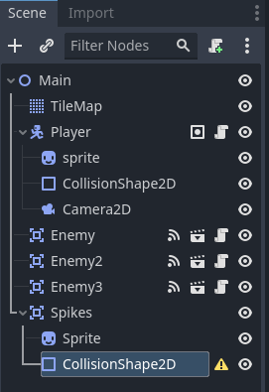
Adding a Collision Shape
We then need to add a collision shape to the spikes node. Right-click on Spikes and choose Add Child Node, and create a CollisionShape2D.

Slide 37
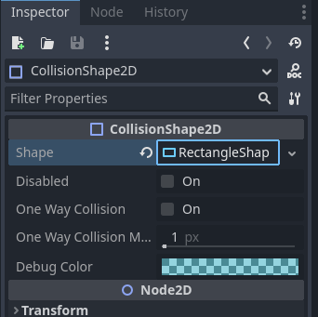
Adding a Collision Shape
Then choose New RectangleShape2D for the Shape property.

Slide 38
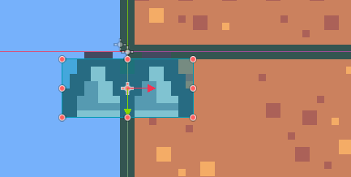
Adding a Collision Shape
Finally, resize it to make sure it covers the Spikes sprite correctly.

Slide 39
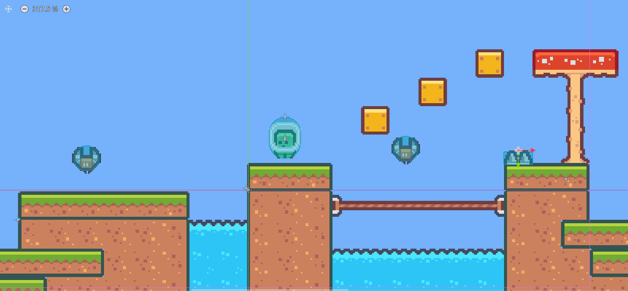
Adding a Collision Shape
Select the Spikes parent node and move the object to somewhere you want in your level. For us, we will place ours on top of a hill section.

Slide 40
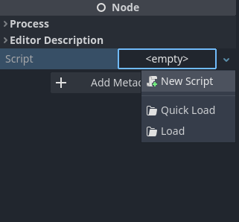
Adding a Script
Finally, we need to attach a script to the spikes node. With the Spikes node selected, choose New Script in the Script property, as we have done previously.

Slide 41
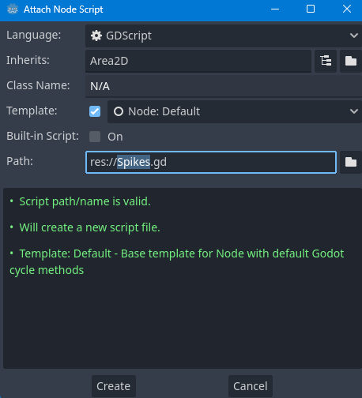
Adding a Script
Make sure the script is named Spikes.gd and that it inherits from Area2D. Then press Create.

Slide 42

Adding a Script
We can then remove the default functions, leaving only the Area2D inheritance call. This should leave your Spikes.gd script looking like the following:

Slide 43
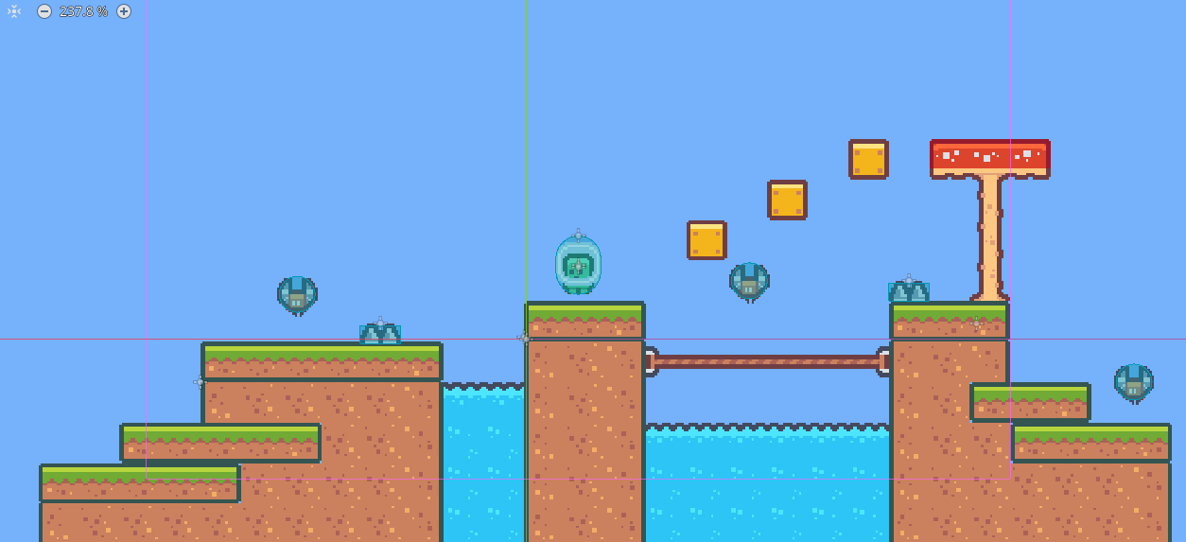
Functionality
The functionality of the script is similar to the enemy script, and I challenge you to create it on your own. In the Enemy.gd script we have an _on_body_entered function, which gets called from the signal in the node panel. When this is called, we check to see if the body is in the Player group. If so, we call the game_over function.

